Slide 1
Simple EDA Team 1
Presentation 1
Meera, Adam, Sana, Marcos

Slide 2
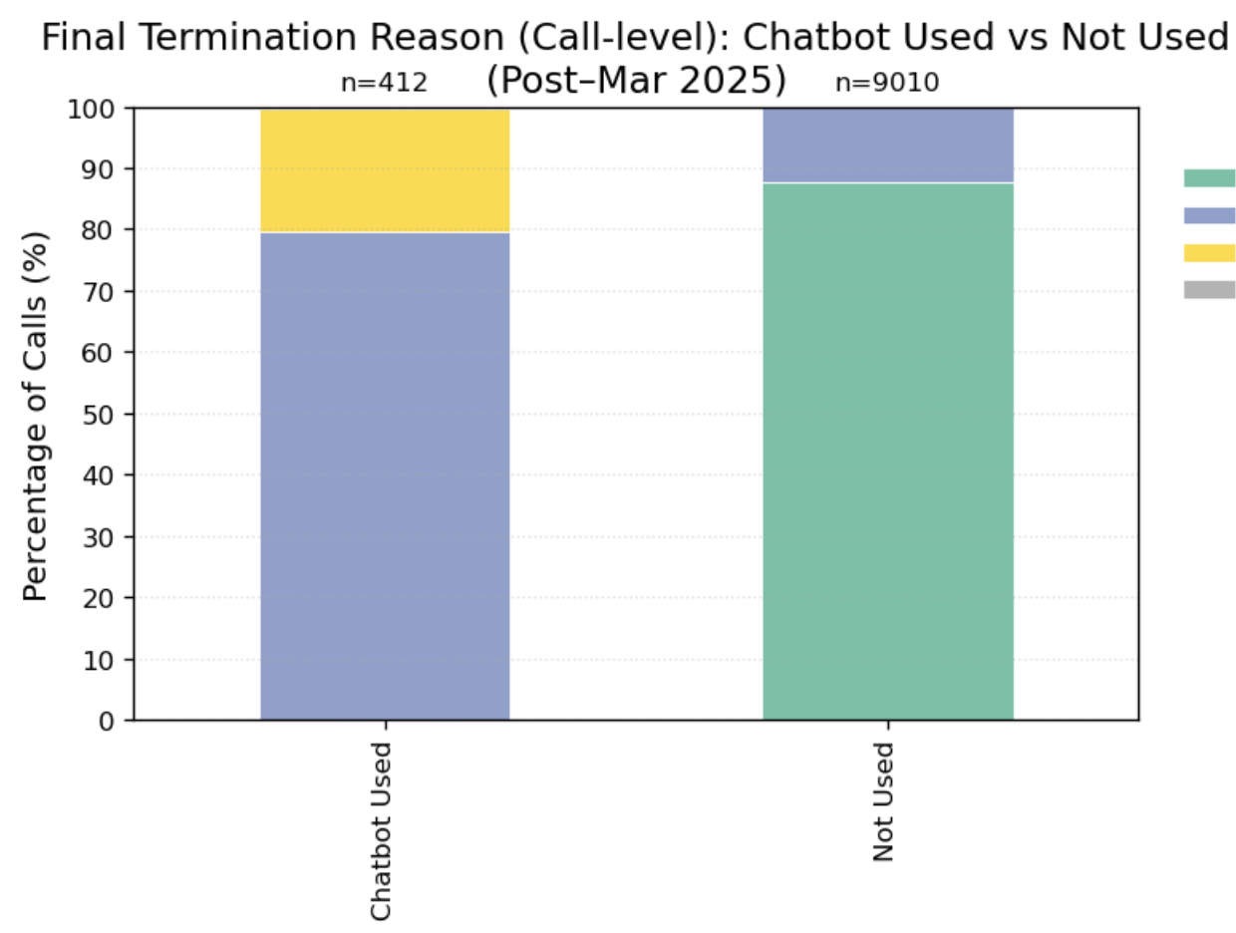
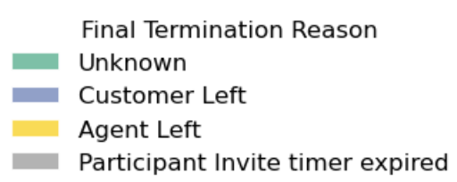
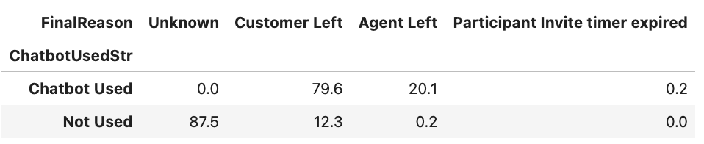
Termination Reason Analysis

Slide 3
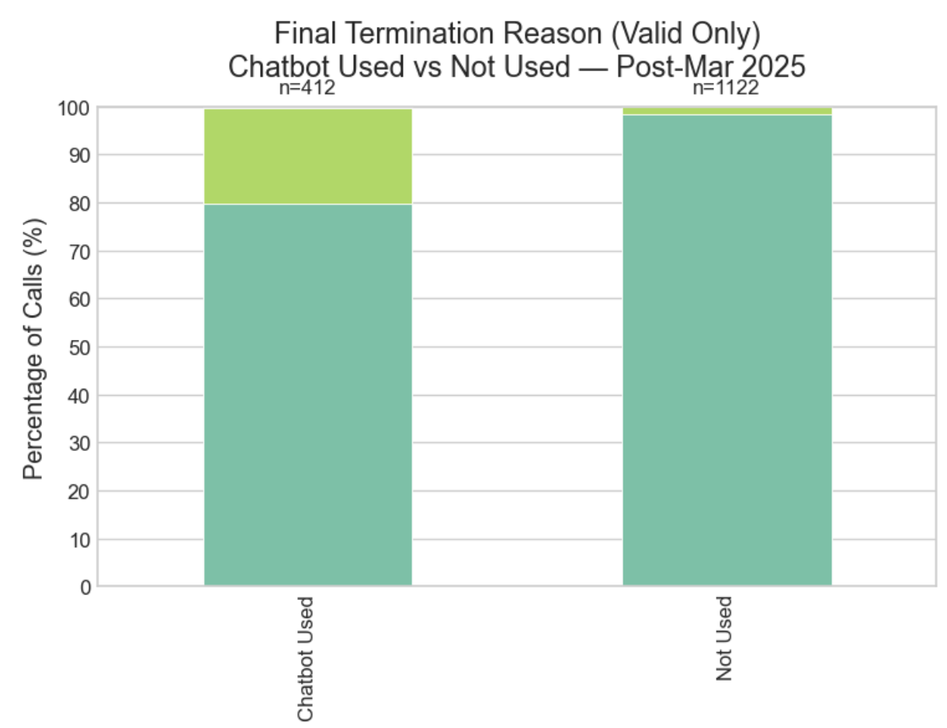
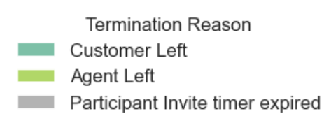
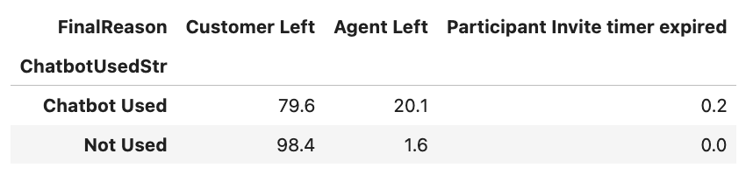
Termination Reason Analysis (w/o Unknown)

Slide 4
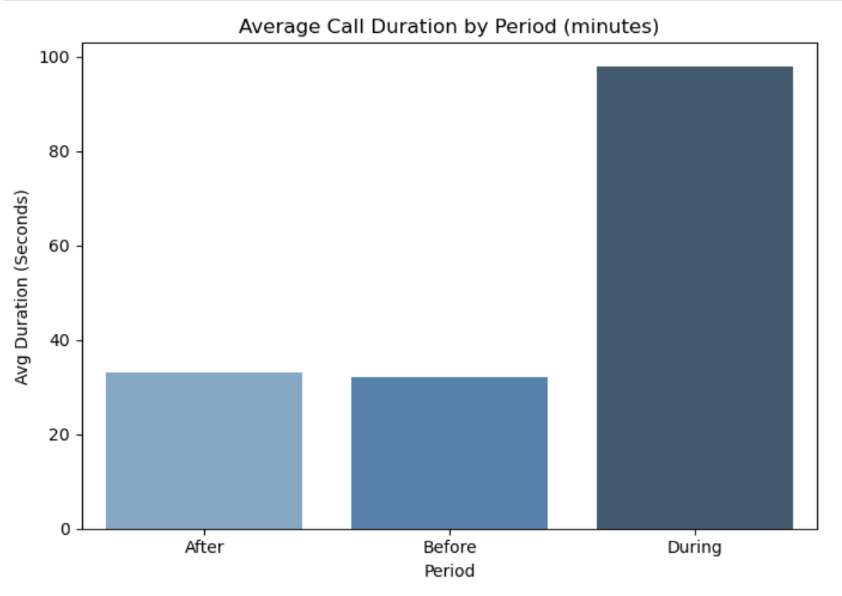
Duration of Calls Analysis
On average call duration tripled in length during the period when the chatbot was used

Slide 5
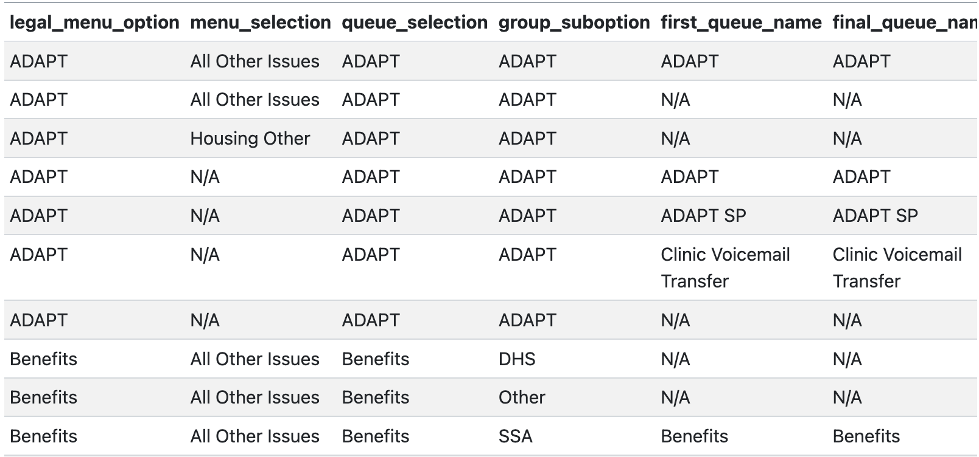
Call Journey Verbiage Analysis - Meera
Purpose: find redundancies in call journey sub-menus
Correct Legal Menu Summary Report Dataset

Slide 6
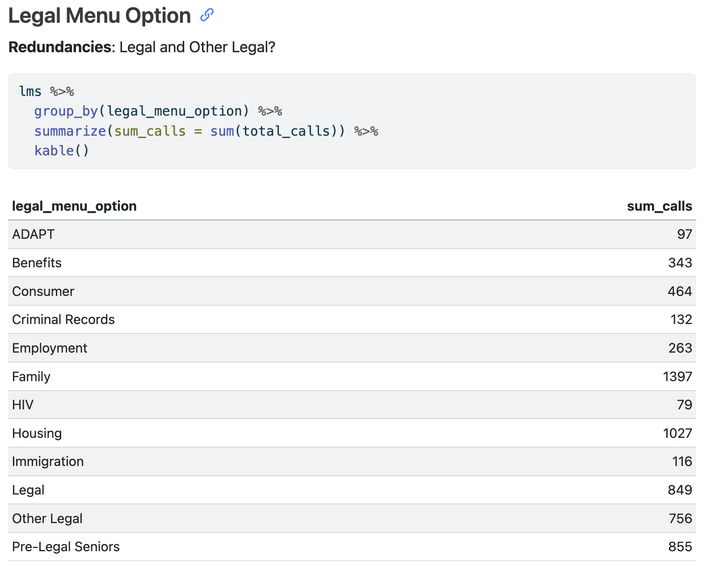
Correct Legal Menu Summary Report Dataset: August 2025

Slide 7
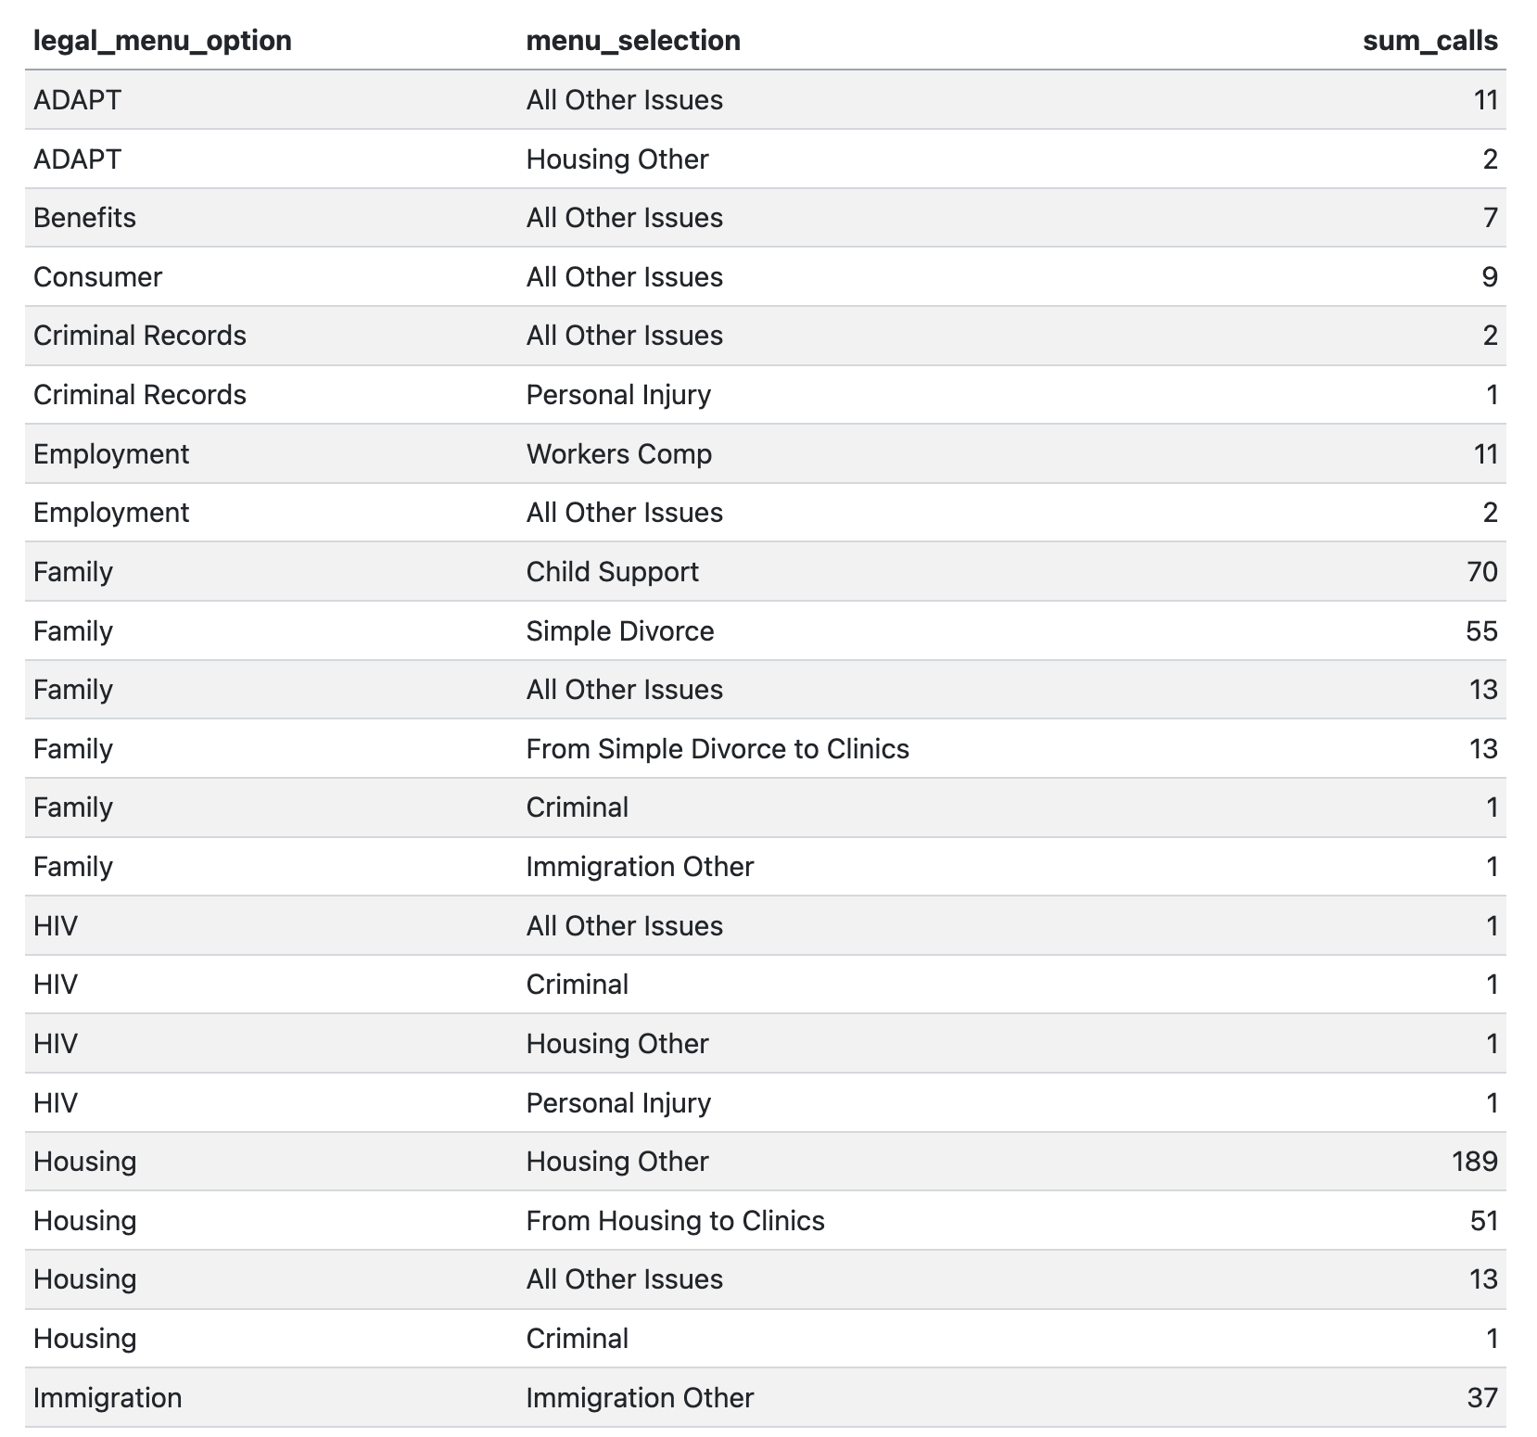
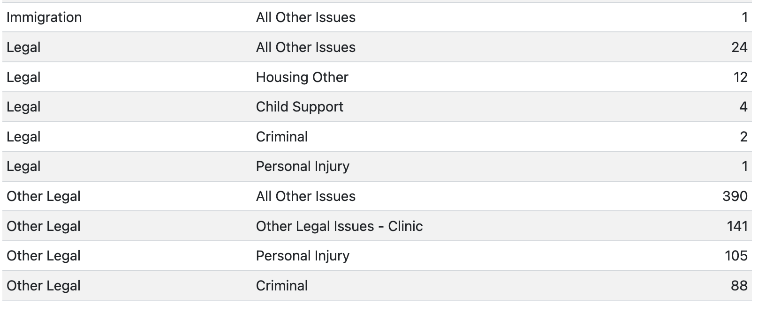
Menu Selection
Why are there separate queues for the same transfer?
Housing >> From Housing to Clinics >> Clinic Voicemail Transfer
Family >> From Simple Divorce to Clinics >> Clinic Voicemail Transfer
Other Legal >> Other Legal Issues Clinic >> Clinic Voicemail Transfer
Notes:
205 calls used three different menus to end up in the same place

Slide 8
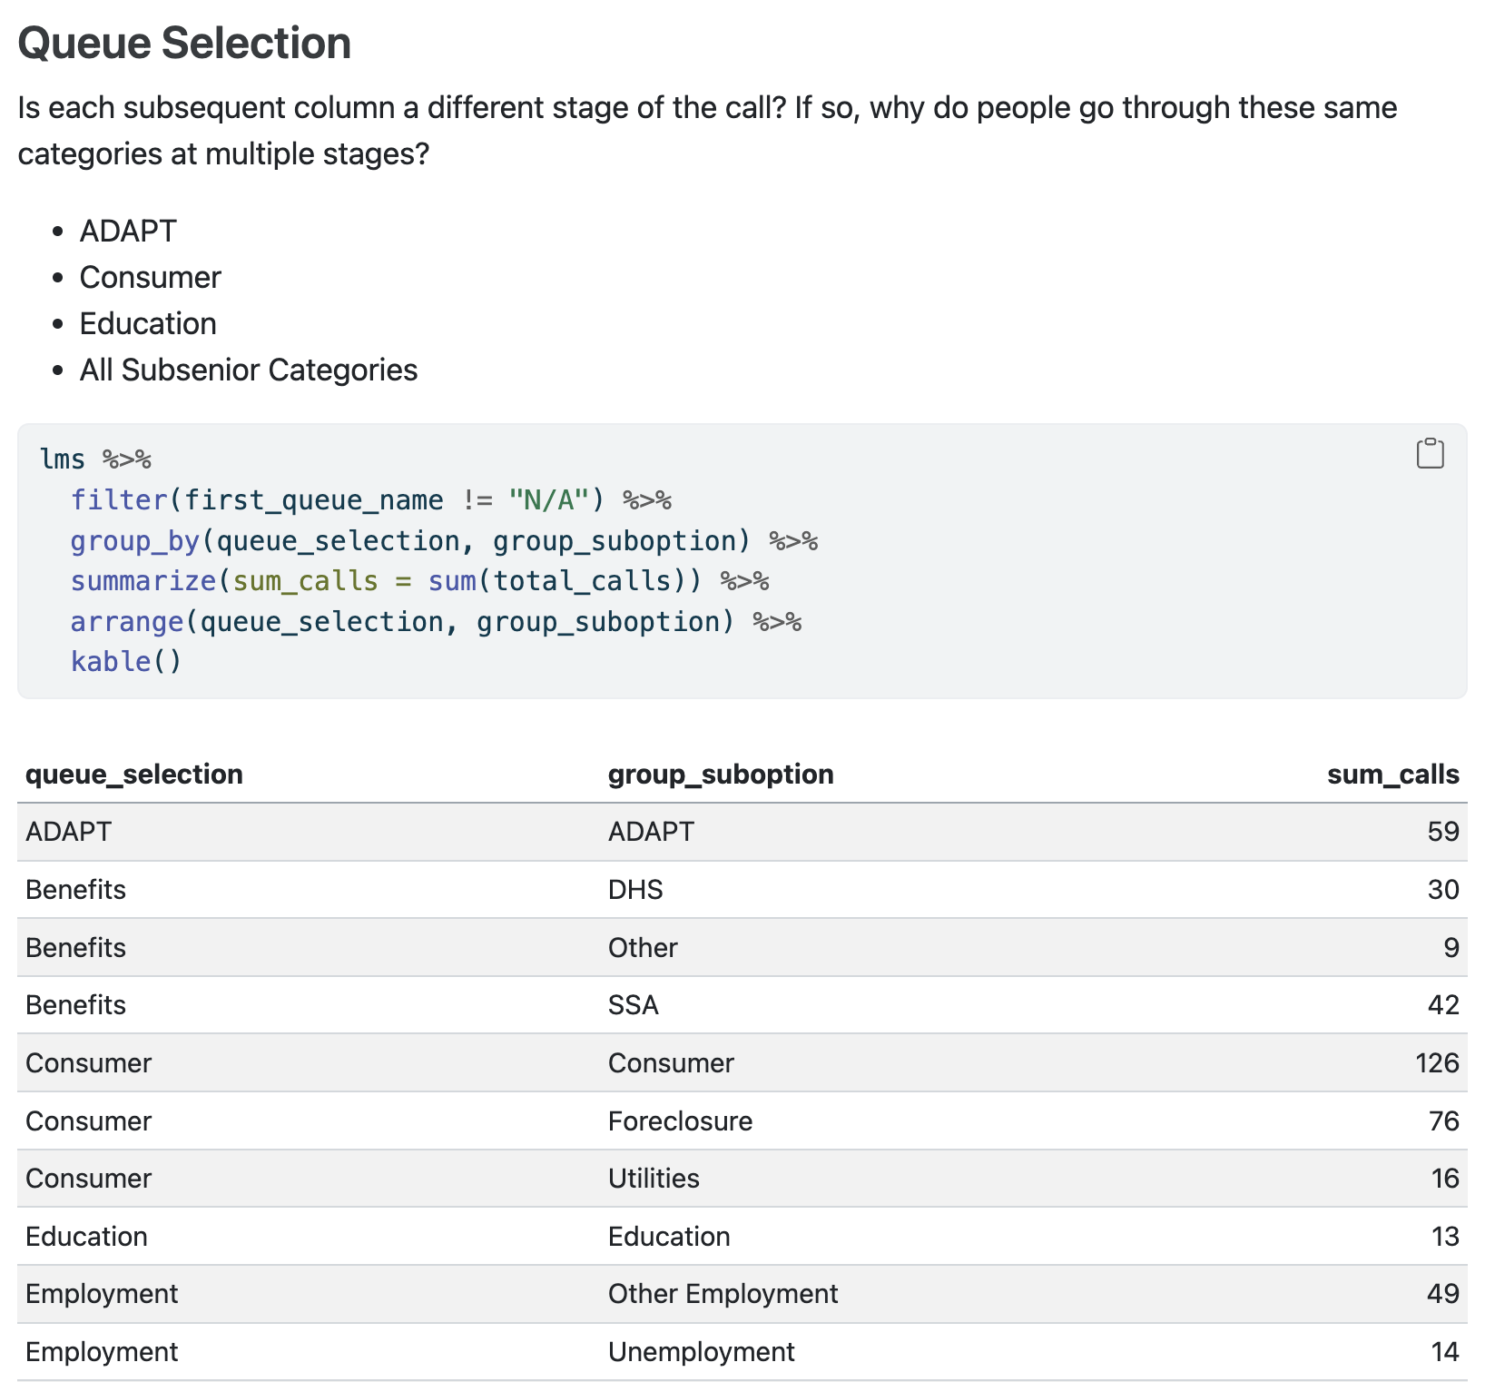
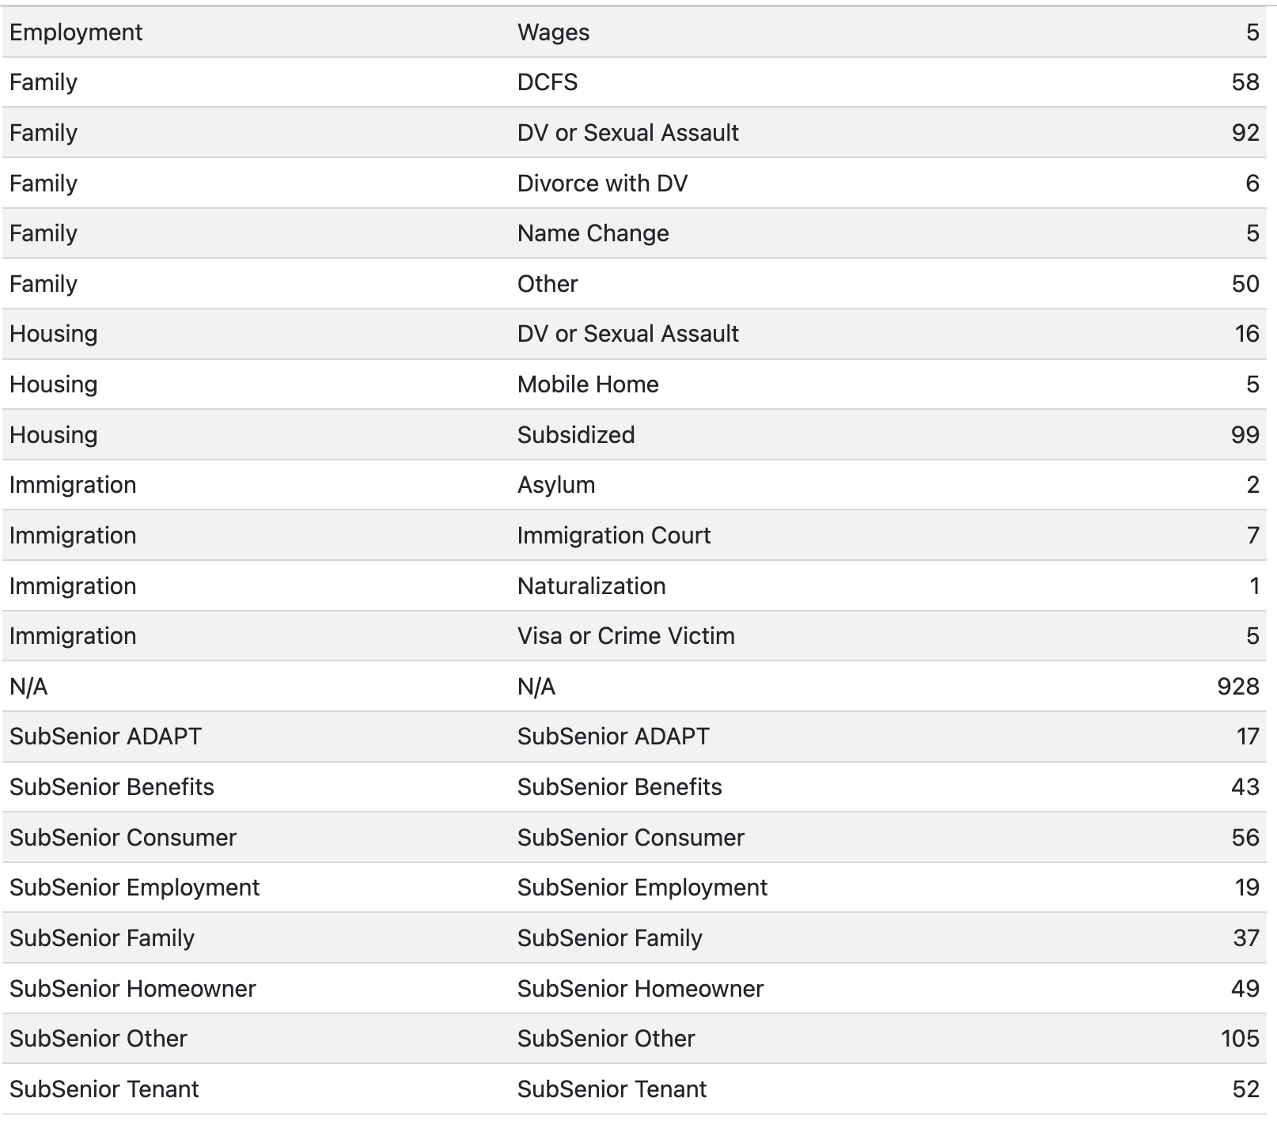
Correct Legal Menu Summary Report Dataset: August 2025

Slide 9
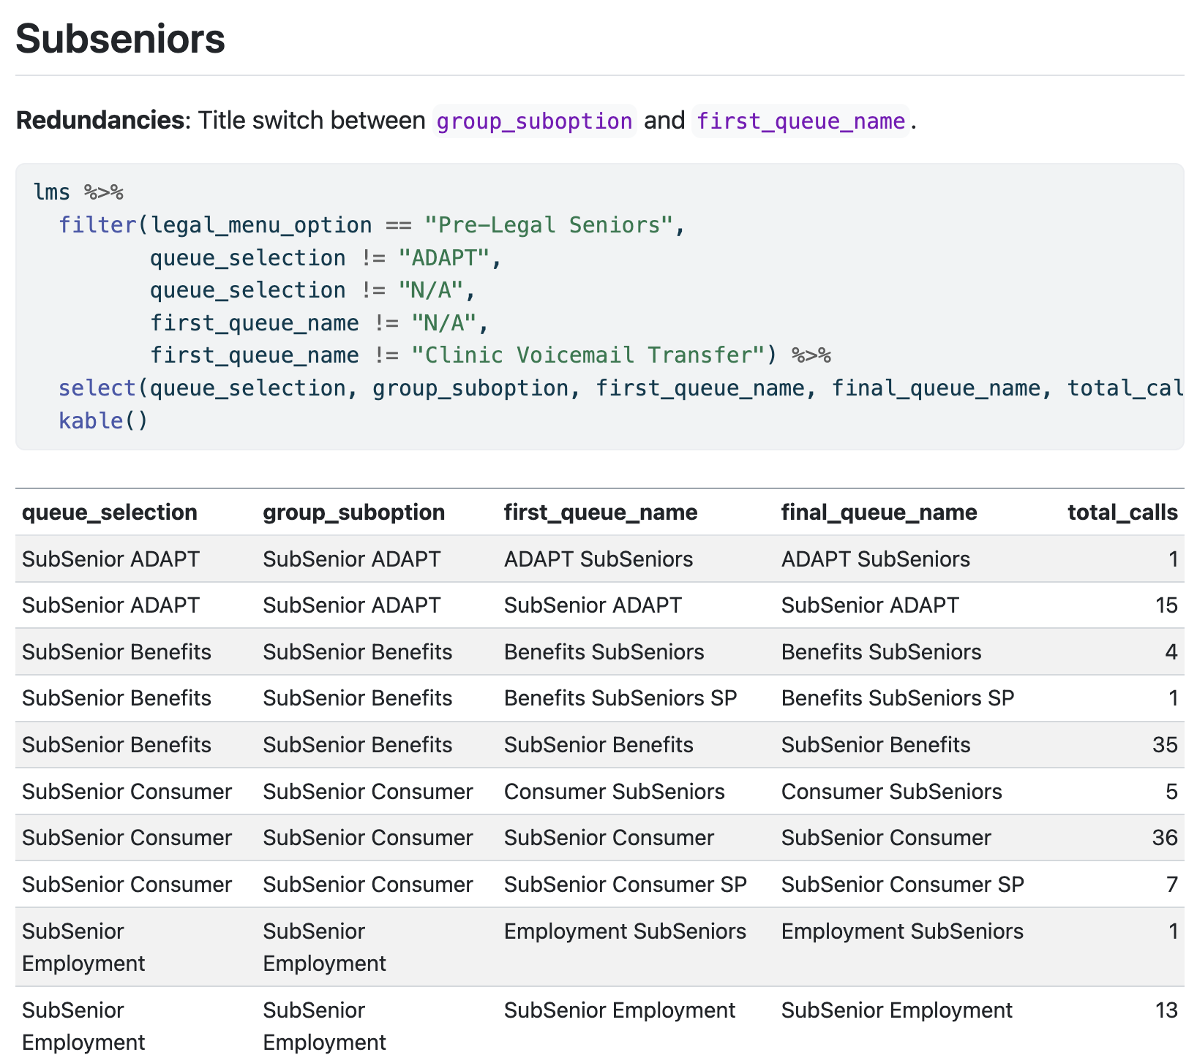
Correct Legal Menu Summary Report Dataset: August 2025

Slide 10
Next Steps - Meera
Merge all monthly sheets into one data file (at least 2025)
Research the given information to:
Understand the difference between queue selection and group suboption
Understand the different labels (ex: SubSeniors ADAPT vs ADAPT SubSeniors)
Potentially dive deeper into optimizing this flow depending on results
Raise the question of unifying the three menu selections that all directed to Clinic Voicemail (to Cynthia)
Continue studying the “Correct Legal Summary Menu Reports” for more redundancies and open call flow doc
Collaborate with Adam + incorporate feedback to refine main analysis points

Slide 11

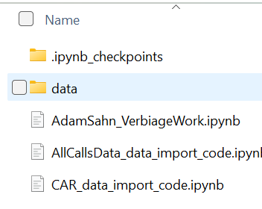
Adam Updates
Data and file organization!
Initial Verbiage Ideas
Next Steps
“Thank you for calling Legal Aid Chicago. Para continuar en español, presione 2. To continue in English, press 1”
Efficient if the majority of callers speak Spanish, but not if there are more English than Spanish speakers!
“If you are calling for help with a legal problem that you have not talked to us about yet, press 3. If you would like to hear about how to meet with a free lawyer in one of our neighborhood clinics, press 4”
Wouldn’t people who should be routed through #4 be likely to click #3 after hearing the prompt of 3?
Take and implement any feedback
Test my verbiage ideas/hypotheses with the given data to either confirm or reject my current hypotheses (Initial Verbiage Ideas)
Continue looking through the “Legal Aid Chicago Contact Center Prompt List Verbiage” to identify potentially confusing or inefficient verbiage, design data-backed methods to test my hypotheses, and make actionable recommendations to Cynthia

Slide 12
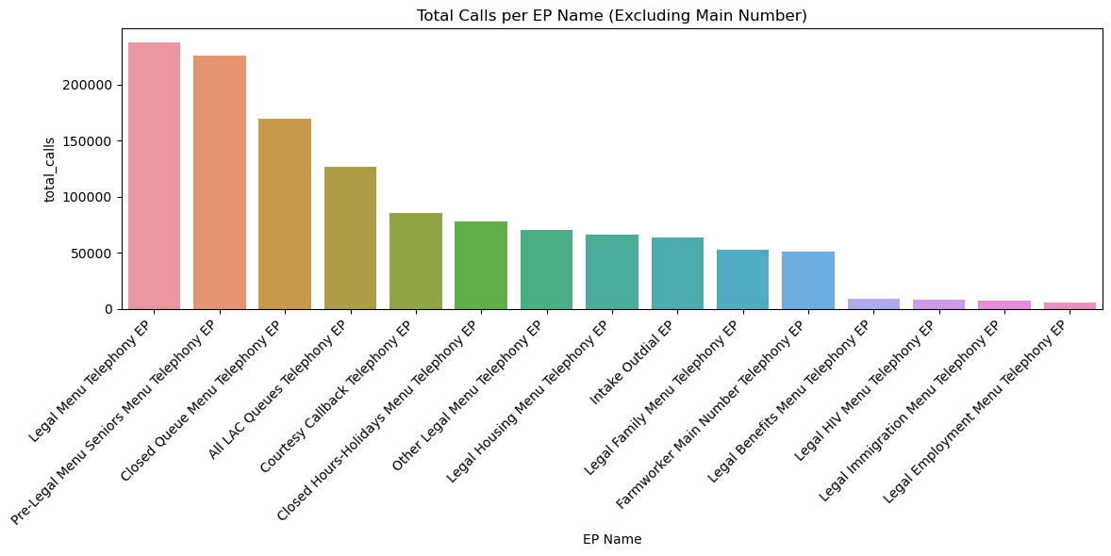
Looking at Popular End Points from CAR Data - Sana
Excluding Main Number Telephony EP (most popular)

Slide 13
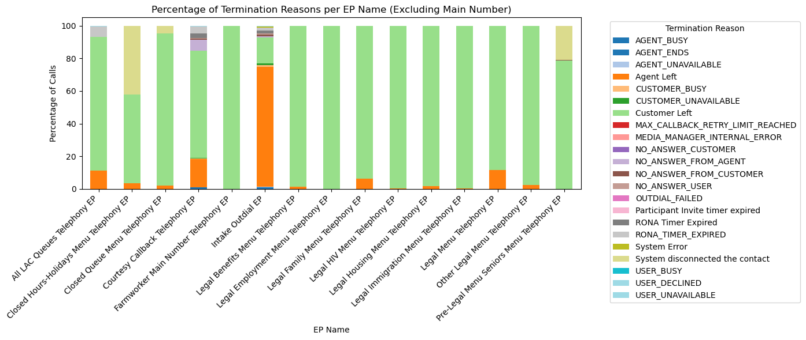
Resource Allocation: Why are calls terminating?
Which lines have a lot of abandoned calls → maybe under-resourced?
System errors common?

Slide 14
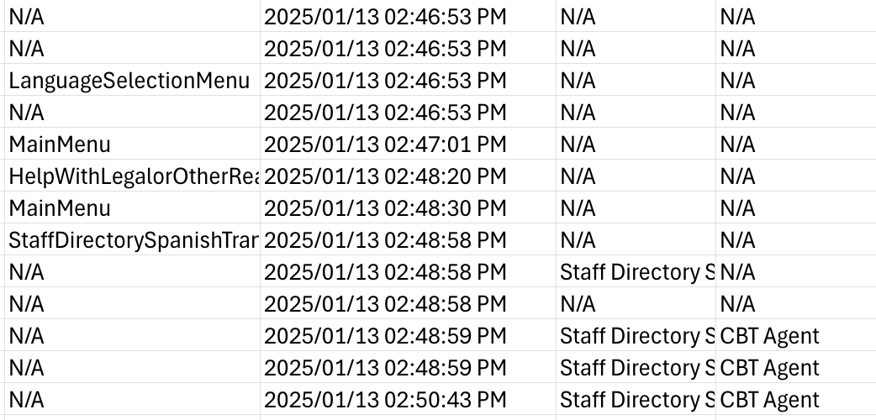
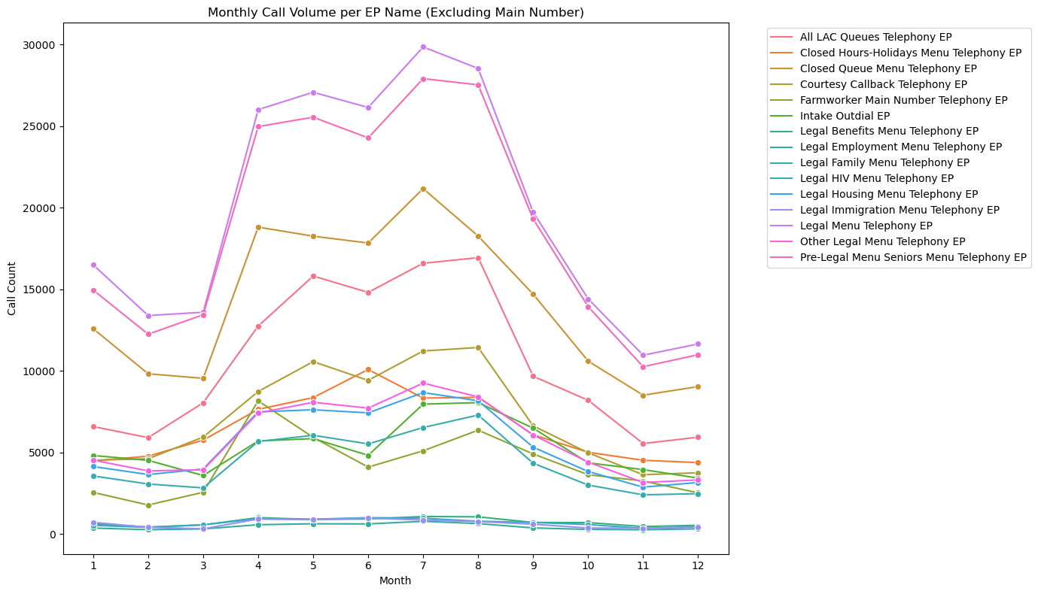
Resource Allocation: Further interests?
Calls by the Hour/Day of the week → M-F 8am-5pm (usual business hours)
General focus on how resources are being utilized currently (language menu)

